Slide 1
Freshmen AxiUm Orientation
January 2018

Slide 2
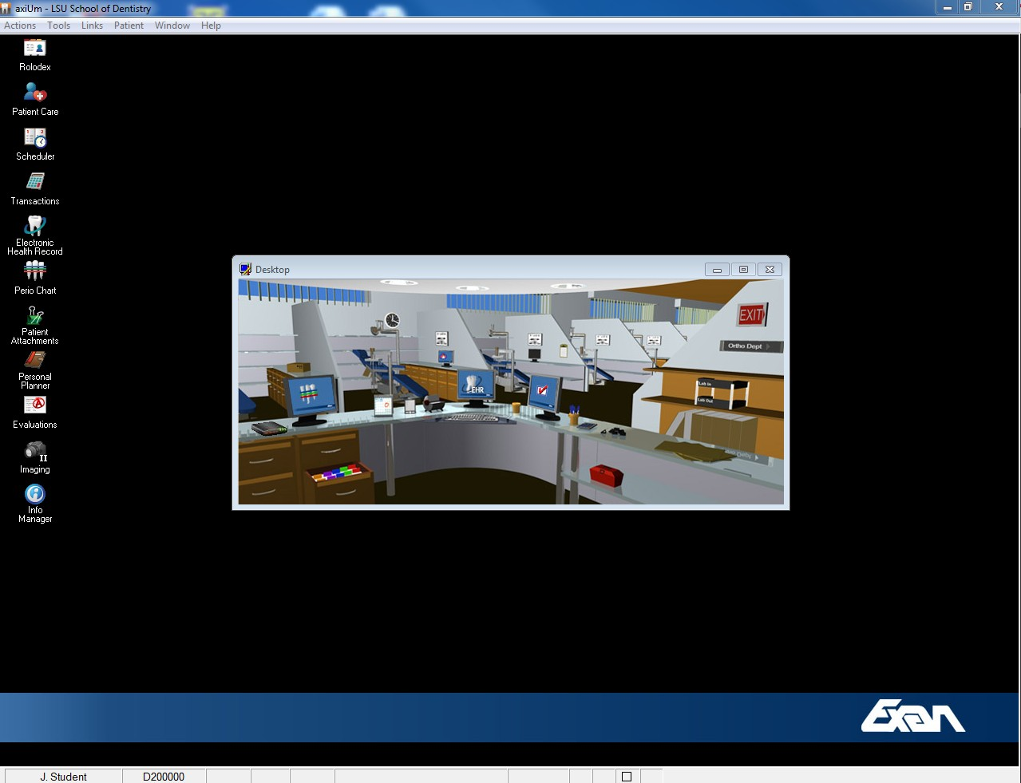
axiUm-LSUSD clinic management system for maintaining patient records in a paperless environment since 2005!

Slide 3

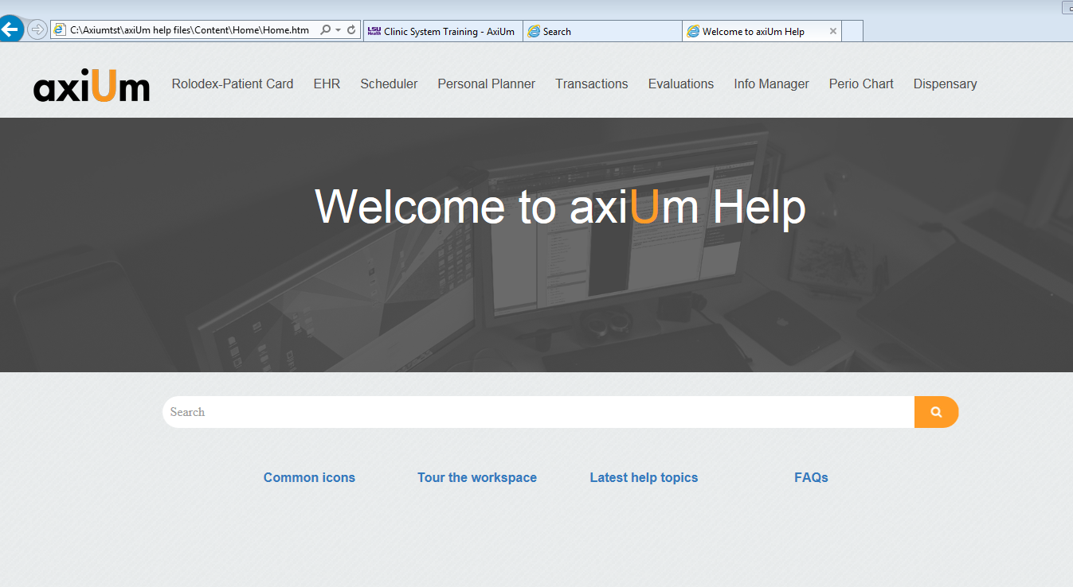
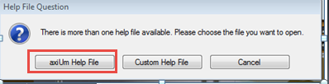
Help is available with 2 options: axiUm Help File button opens company website

Slide 4
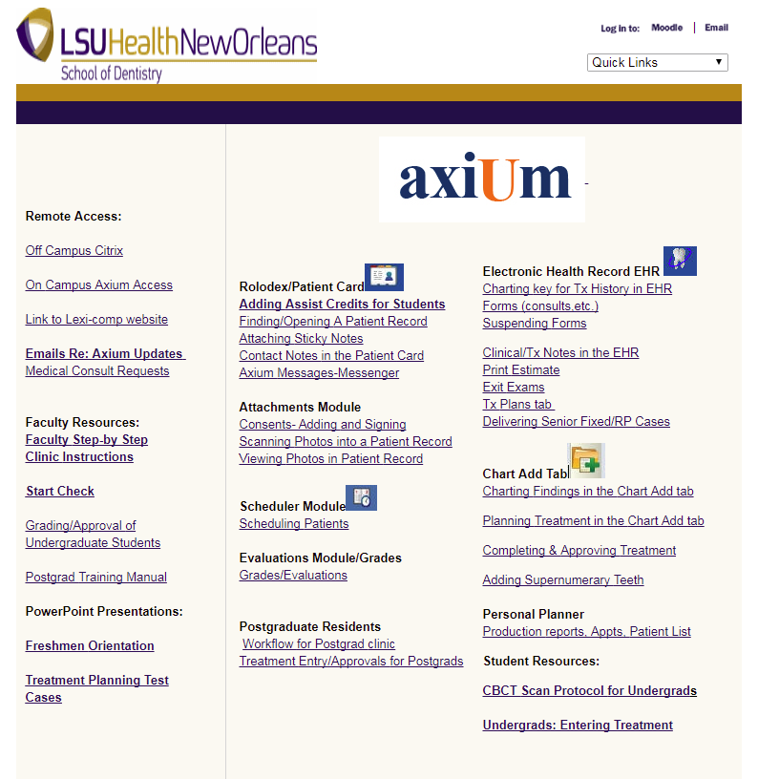
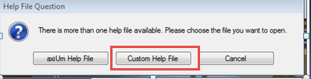
Custom Help file button opens LSUSD axiUm Help page

Slide 5
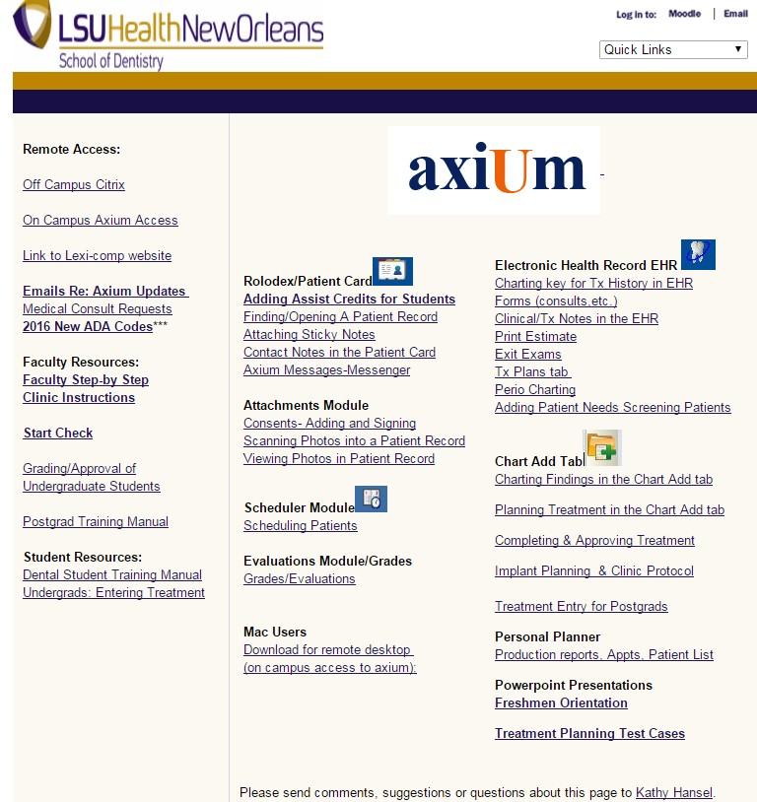
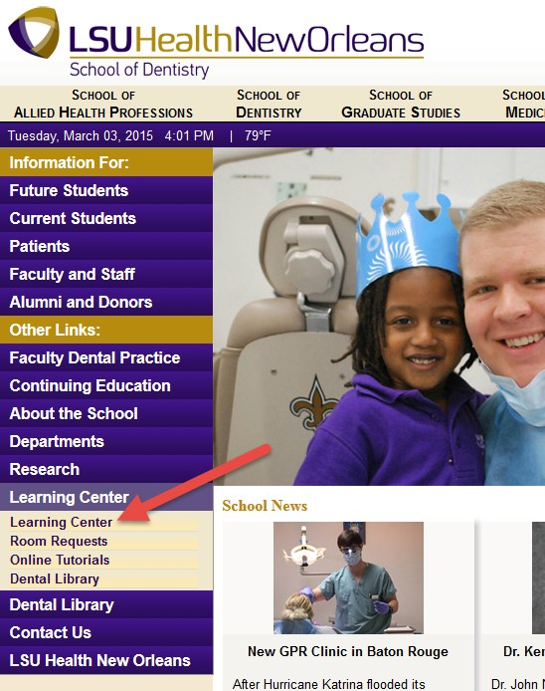
Axium Training -LSUSD website- Learning Center

Slide 6
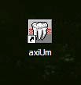
AxiUm
Workstations are provided in each cubicle
Do not use your personal laptops in clinic, may not allow proper entry of faculty approval codes
Log onto clinic stations using your LSU username and password
Click on the axium icon and use your axium username and password
Log off when finished for the day

Slide 7
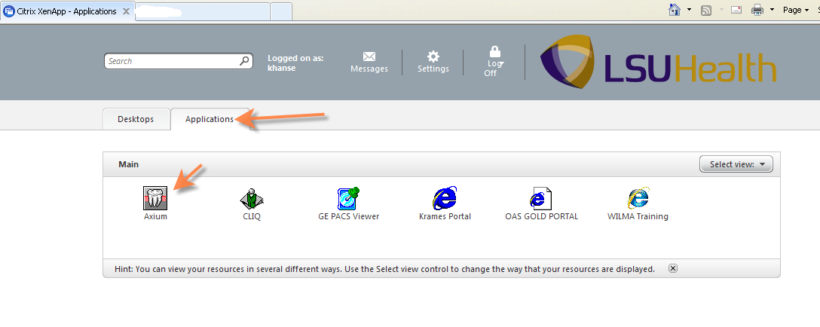
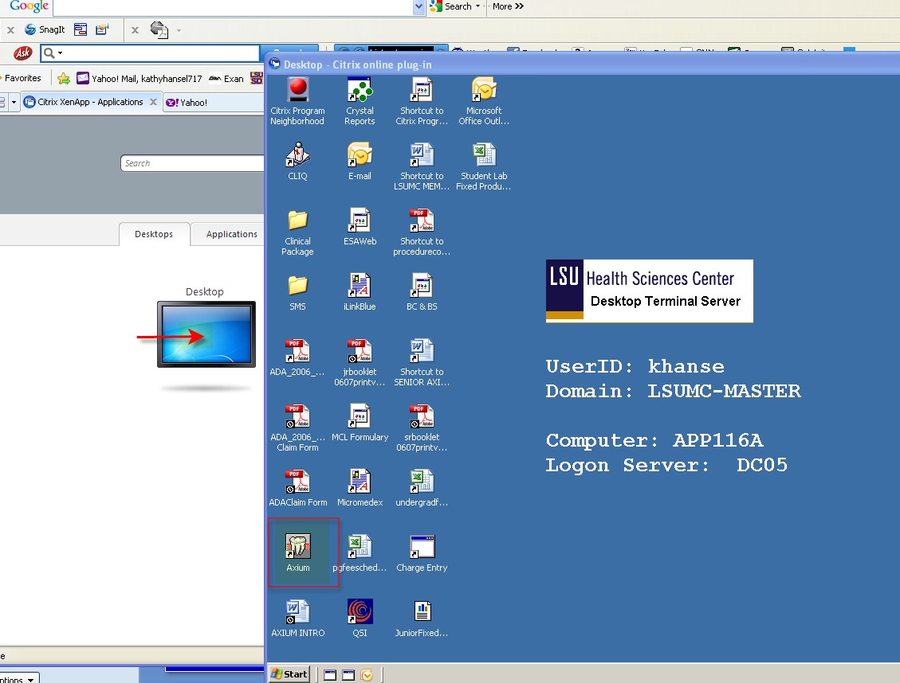
Off campus - Remote access- Citrix- Applications tab- Axium

Slide 8
HIPAA Policies
Patient records contain personal and medical information that must be safeguarded and respected.
Do not view patient records in public places via remote connection to axium- violation will result in dismissal from dental program
Do not discuss patients outside clinic (includes the elevator)
Printing of patient records is restricted
Axium automatic logout- 30 minutes

Slide 9
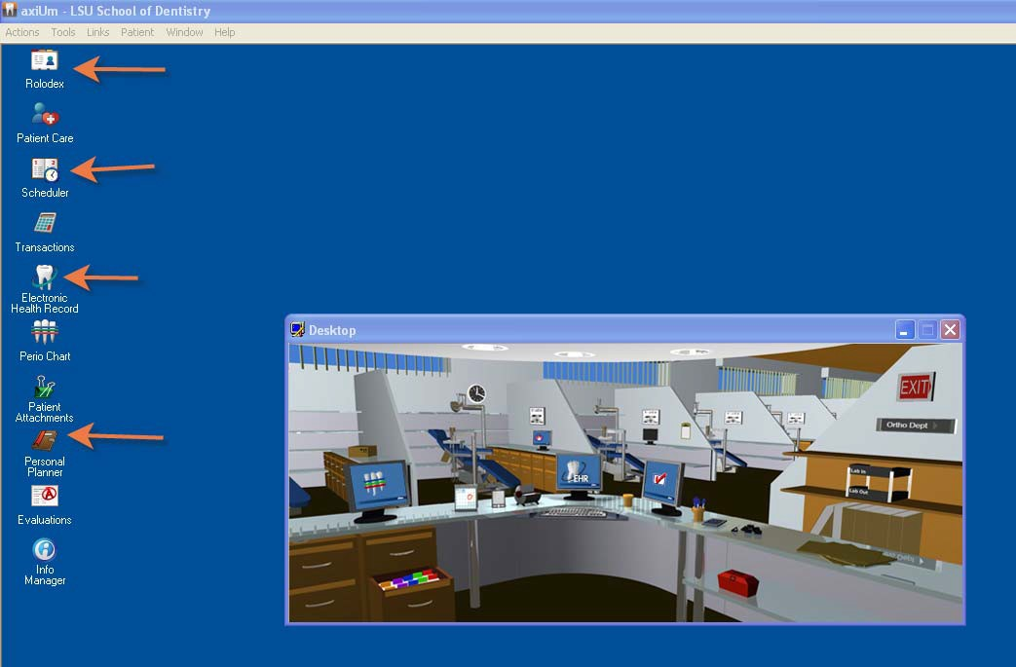
Axium- organized into modules for different functions and security access

Slide 10

Axium Security
Undergraduate Students- limited access to patient records- must be assigned as a provider
Postgraduate Residents- free access to patient records
Staff cannot access all parts of a patient record to protect privacy

Slide 11
Axium login
jstude (Joe Student) 1st letter of first name, first 5 letters of last name
Axium password problems- Kathy Hansel
LSU password problems- IT (568-HELP)

Slide 12
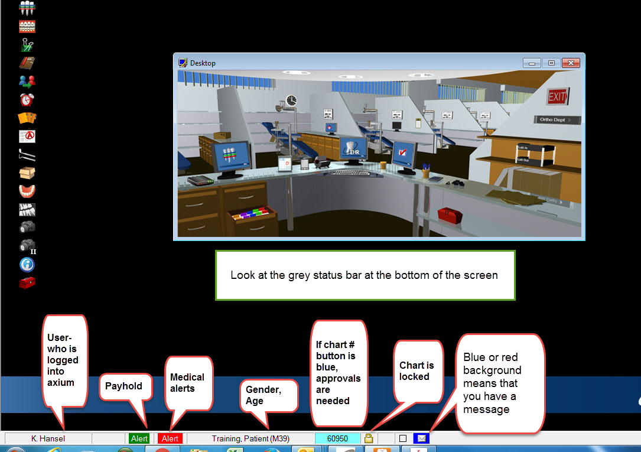

Slide 13
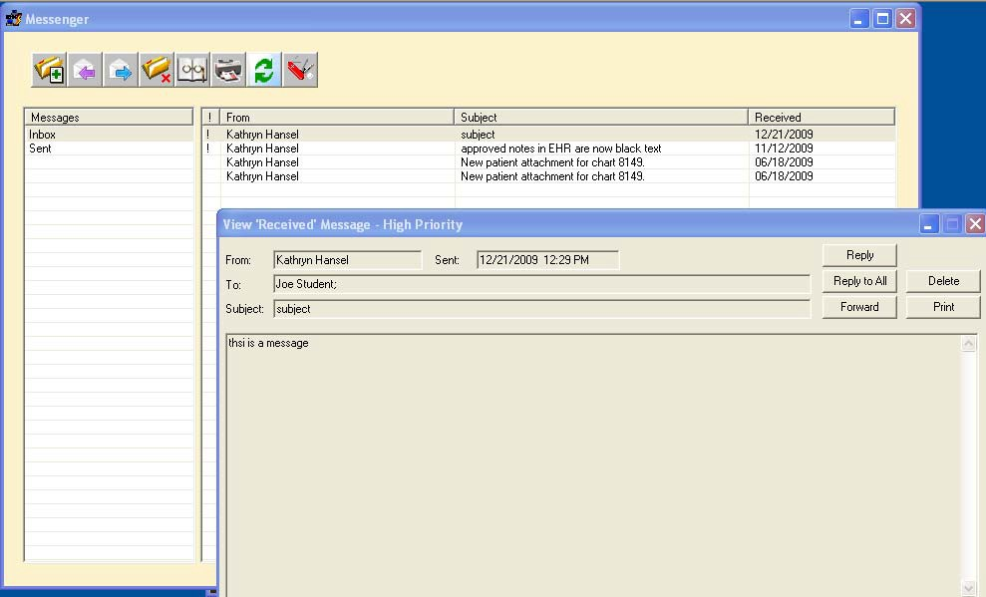
Click on message icon at bottom of screen –blue or red background means you have a message

Slide 14
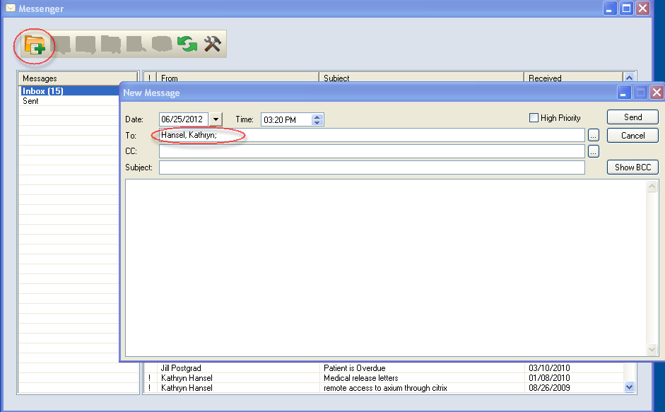
Messenger allows you to send and receive messages through axiU,,m

Slide 15
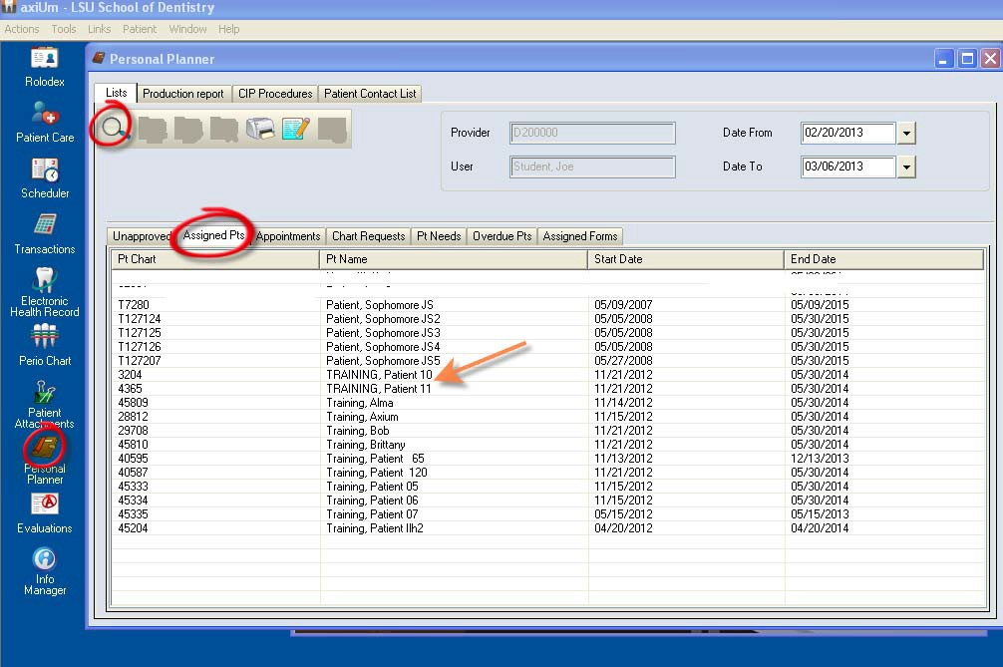
Finding your assigned patient for training- click on Personal Planner- select Assigned Pts tab & hit search button (magnifying glass)

Slide 16
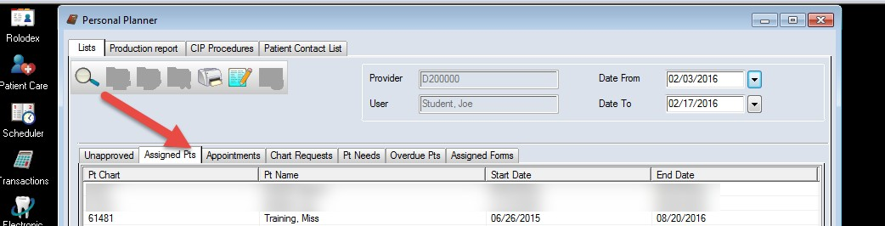
Here is your assigned patient for training

Slide 17
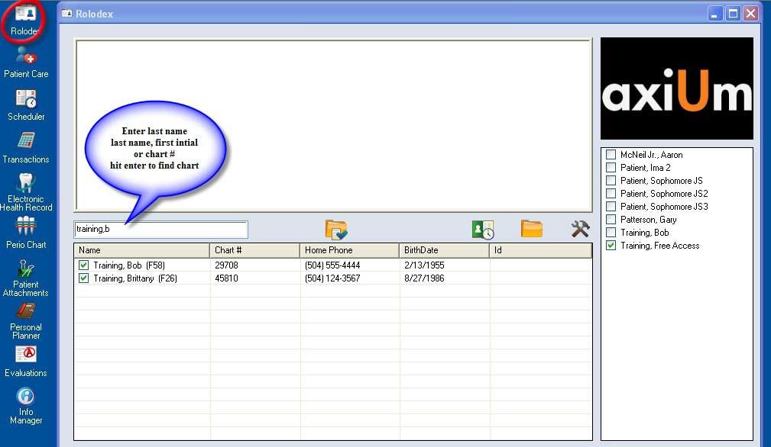

Rolodex- opening a patient’s chart

Slide 18
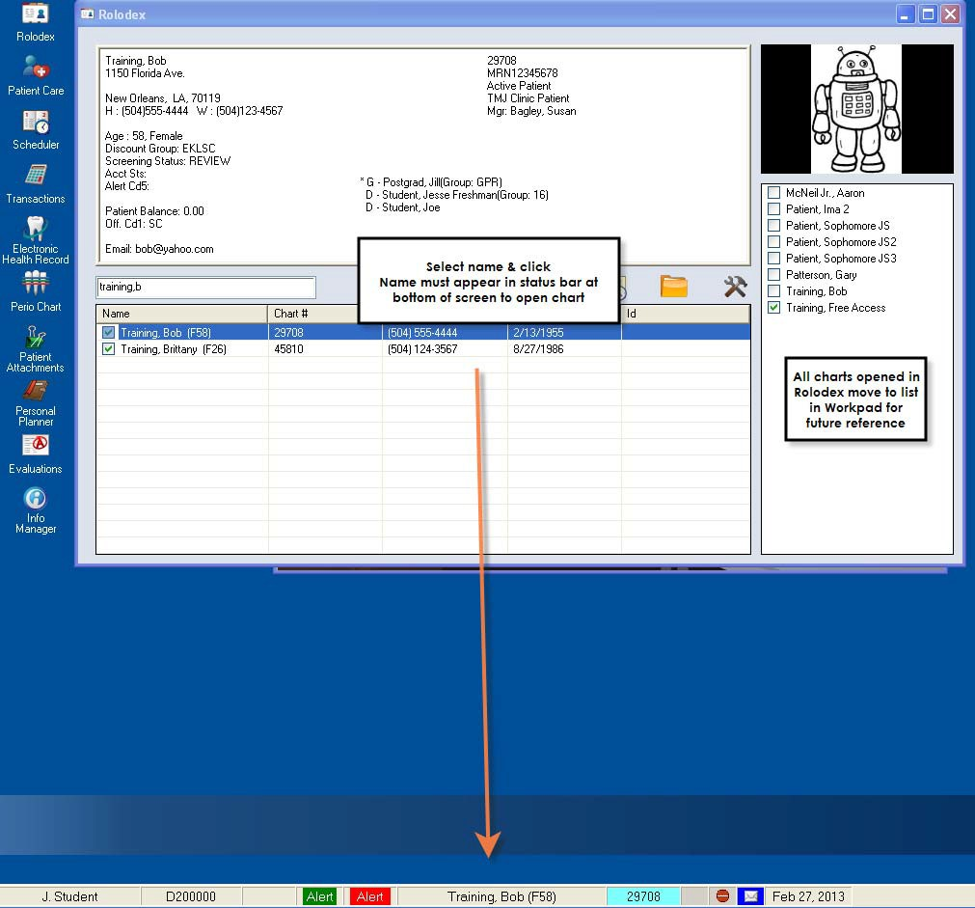
Open a patient’s chart
Chart is open when name displays in status bar at bottom of screen – (gender,age) appear next to name

Slide 19
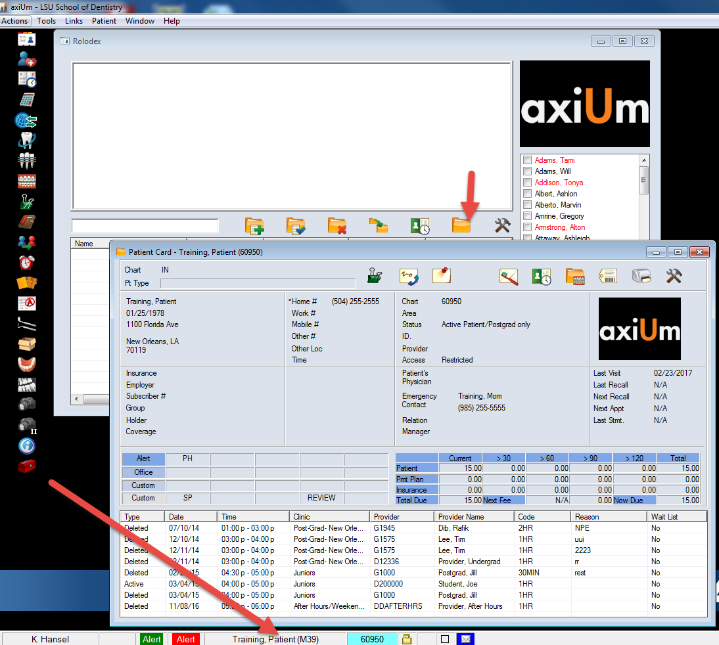
Open the patient card from the Rolodex or by clicking on the patient name in status bar

Slide 20
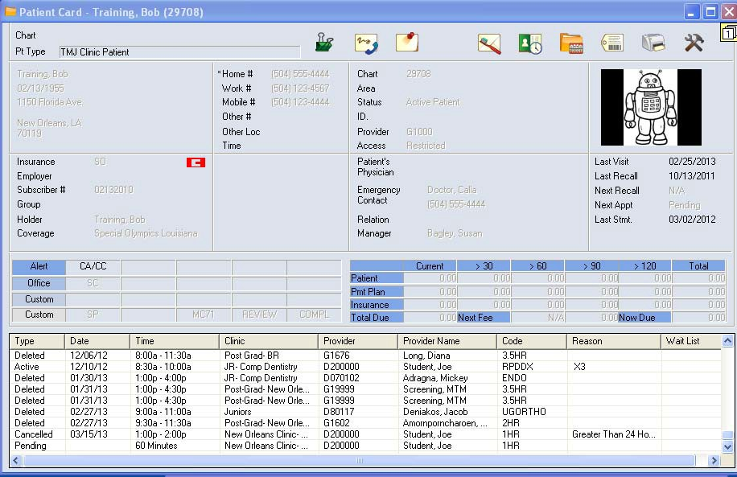
Patient Card contains personal info, phone numbers, emergency contact and list of appointments at bottom of window

Slide 21
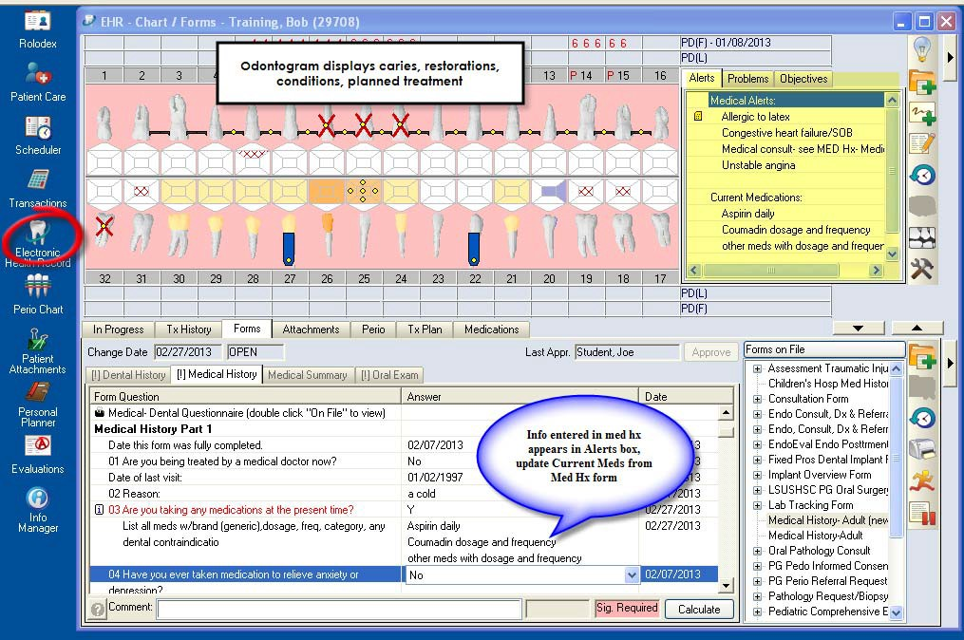
Select EHR to open the chart

Slide 22
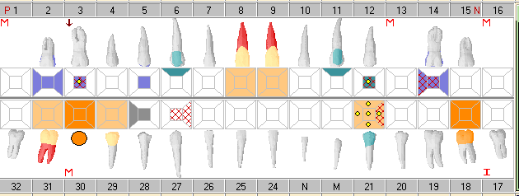

Odontogram displays:
Initial findings- existing restorations, caries (red cross hatching), conditions
Planned treatment procedures (yellow dots)
Treatment in process and completed

Slide 23
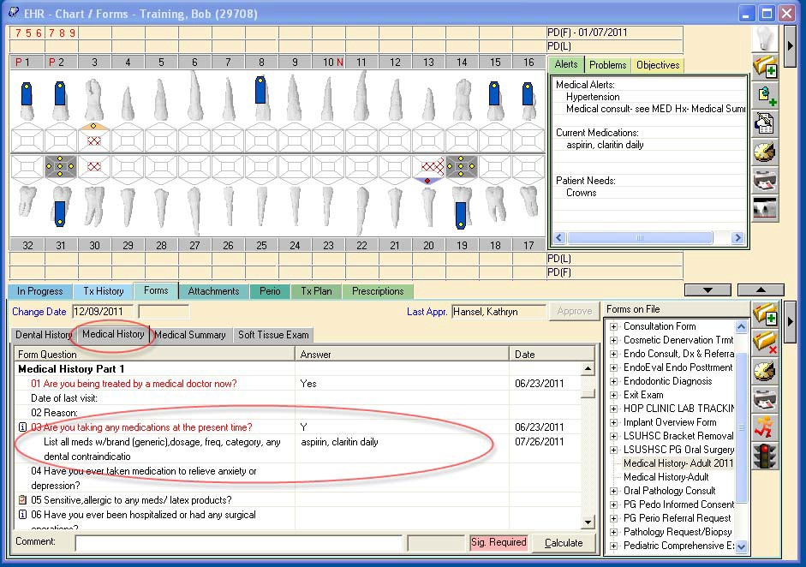
Update the medications from the Medical History- displays in Alerts box

Slide 24

Check medical history
Patient must sign for any changes in medical history
Electronic signing pads are located at the front desk with the scheduling clerks
Sig required button at bottom of screen turns pink

Slide 25
Look down to the Status Bar for important notifications
Intervention- Action required!
Medical history needs update!
Patient’s signature required on a form

Slide 26
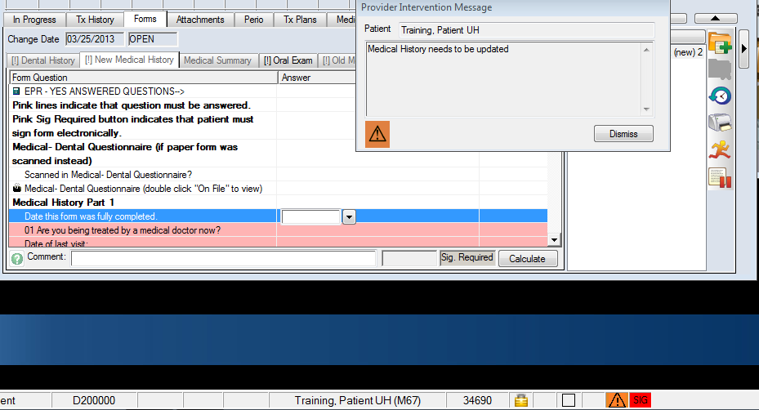

Message window appears when EHR is opened explaining what action is needed-
Medical History needs to be updated (last update > 2 years ago)

Slide 27
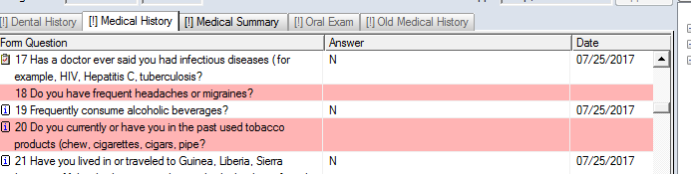
Answer all questions- pink lines are required answers

Slide 28
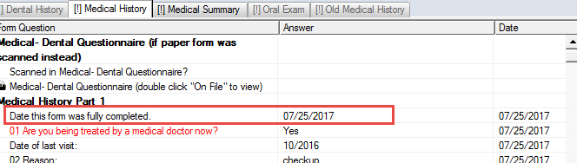
Important!!!!
Enter today’s date to answer
“Date this form was fully completed”

Slide 29
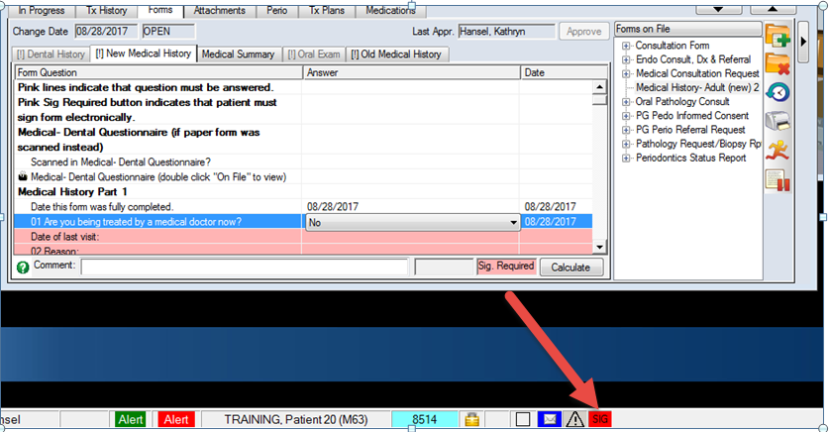
SIG – signature required on medical history form
Once the form is signed by the patient, click on
to remove it from the status bar

Slide 30
Click on the Intervention symbol in the status bar to see any remaining interventions needed

Slide 31
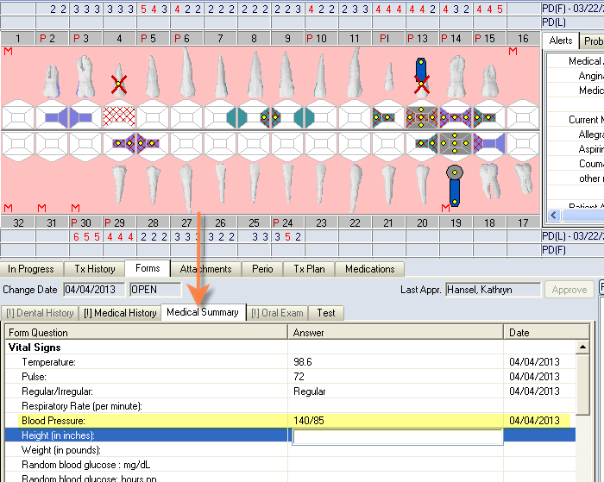
***Medical Summary Page- BP readings must be recorded here at EVERY visit

Slide 32
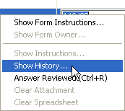
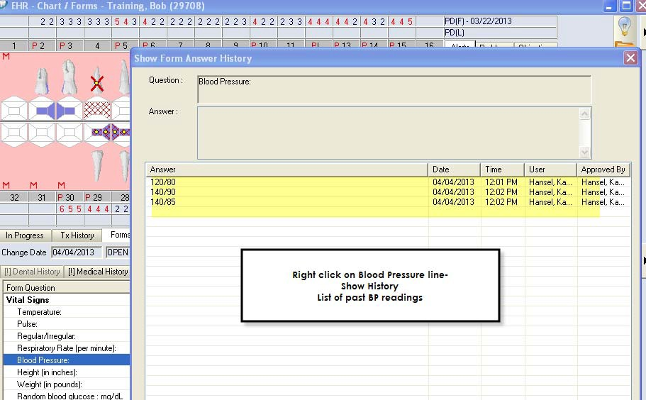
BP Readings

Slide 33
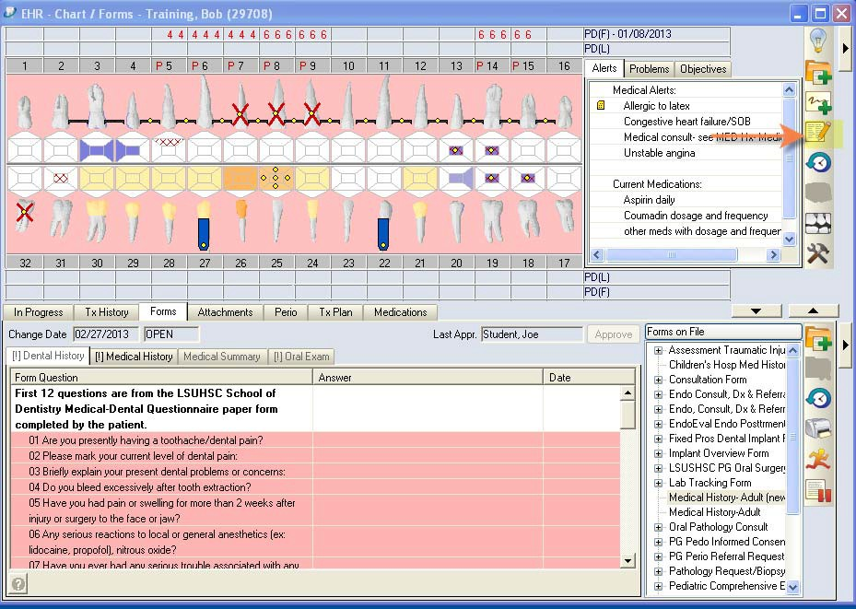
To add a form- click on the Add Patient Form button on top toolbar

Slide 34
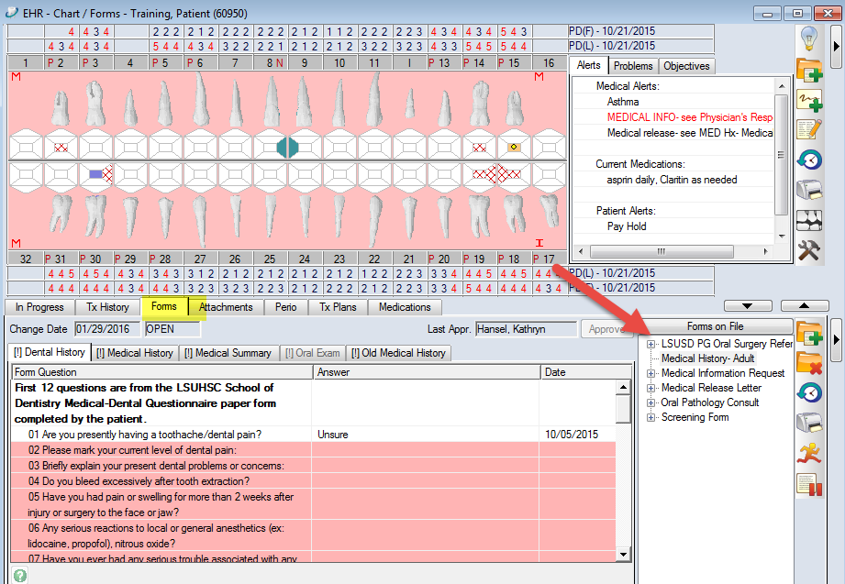
See Forms on File (lower right) for list of forms for this patient

Slide 35
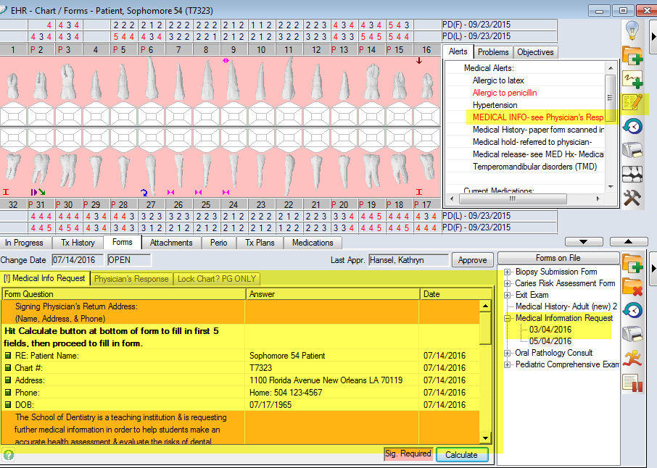
Medical Information Request
1- Select MCR form
2- Calculate button fills in first 5 lines of form with patient info
3- Complete all pink lines
4- Bring patient to front desk to sign form and print.
HAT will lock the chart for Medical Hold.

Slide 36
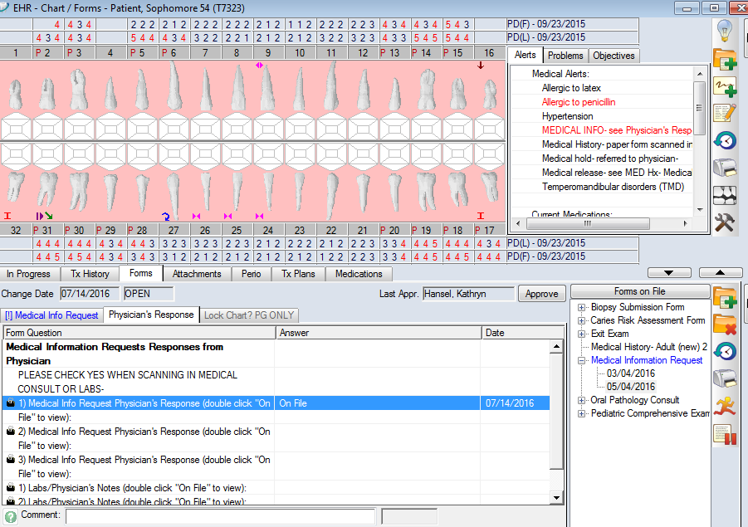
Physician’s Response- patient or physician returns form which is scanned into the Physician’s Response tab

Slide 37
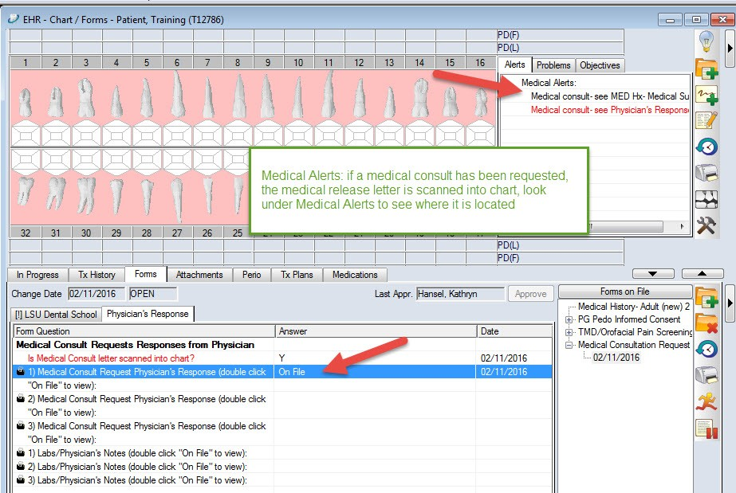
Click On File to view the scanned document

Slide 38
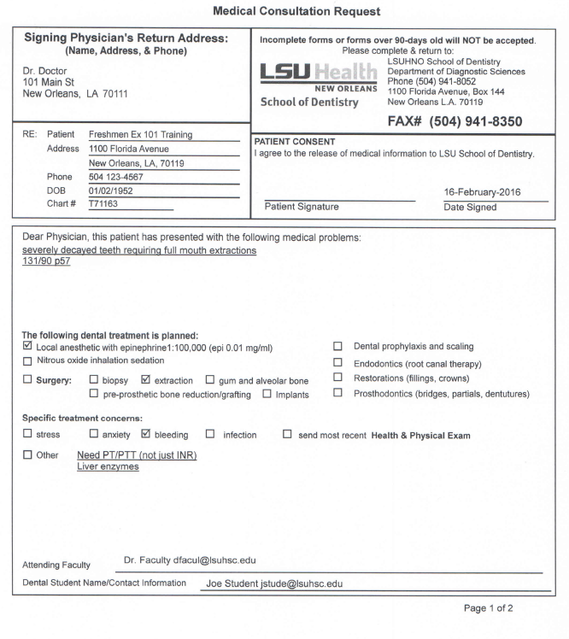
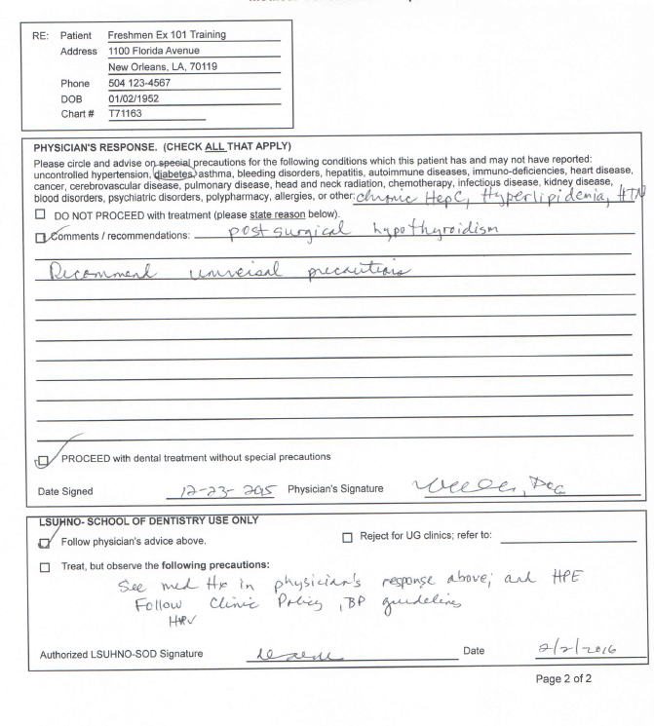

Page 1- printed and given to patient to bring to physician
Page 2- completed by physician and returned to clinic

Slide 39

EHR module
Charting findings
Add planned treatment
Add treatment notes

Slide 40
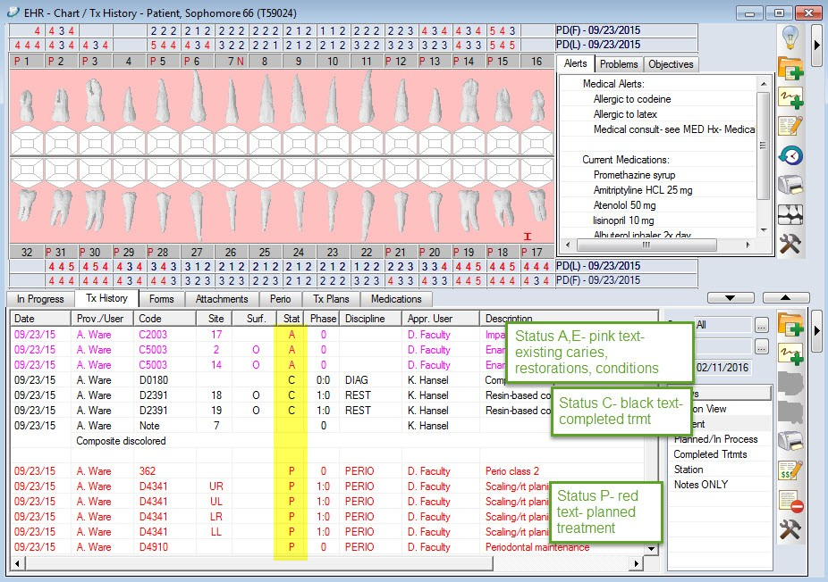
Tx History tab in EHR

Slide 41
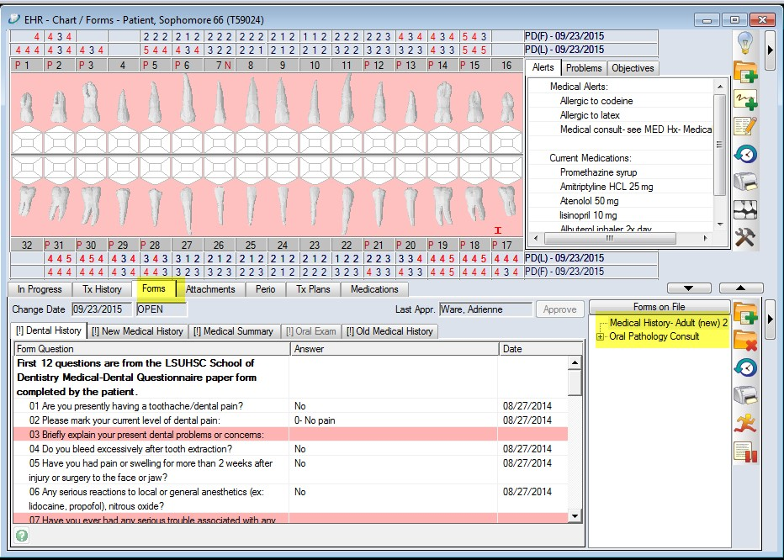
Forms tab

Slide 42
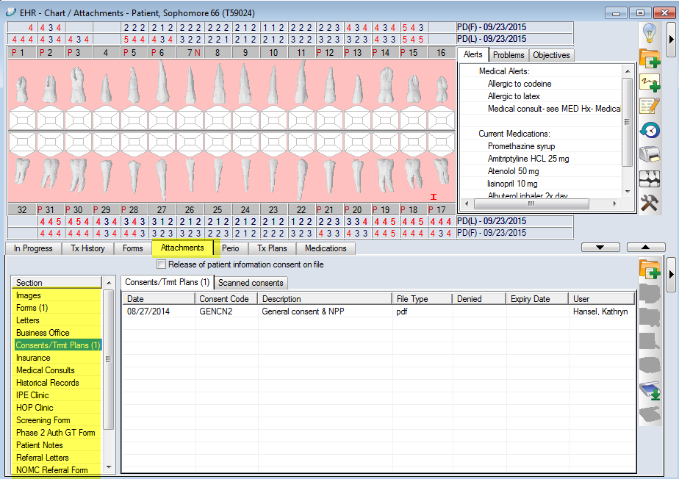
Attachments tab

Slide 43
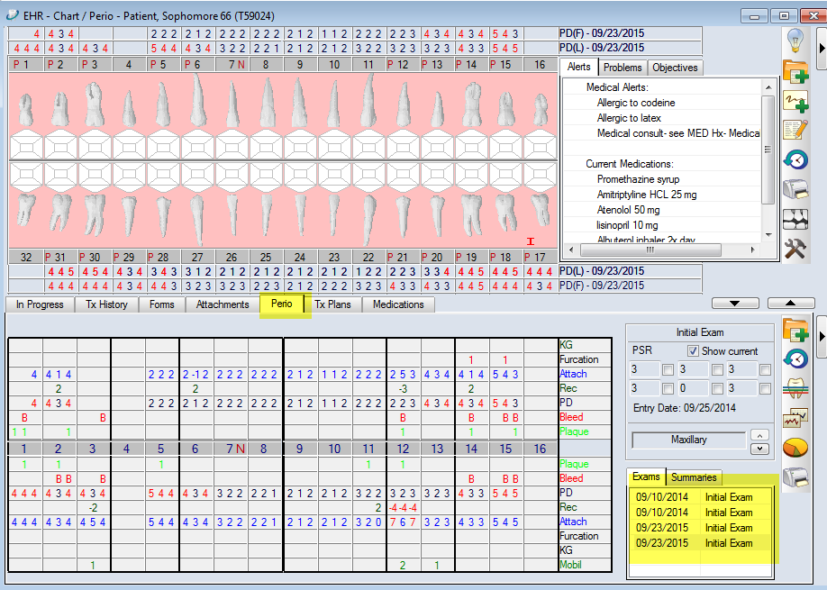
Perio tab

Slide 44

Dental Charting
To chart findings and plan treatment
To ADD findings or treatment to the CHART, you must first open the CHART ADD tab
Hit the create new record button

Slide 45
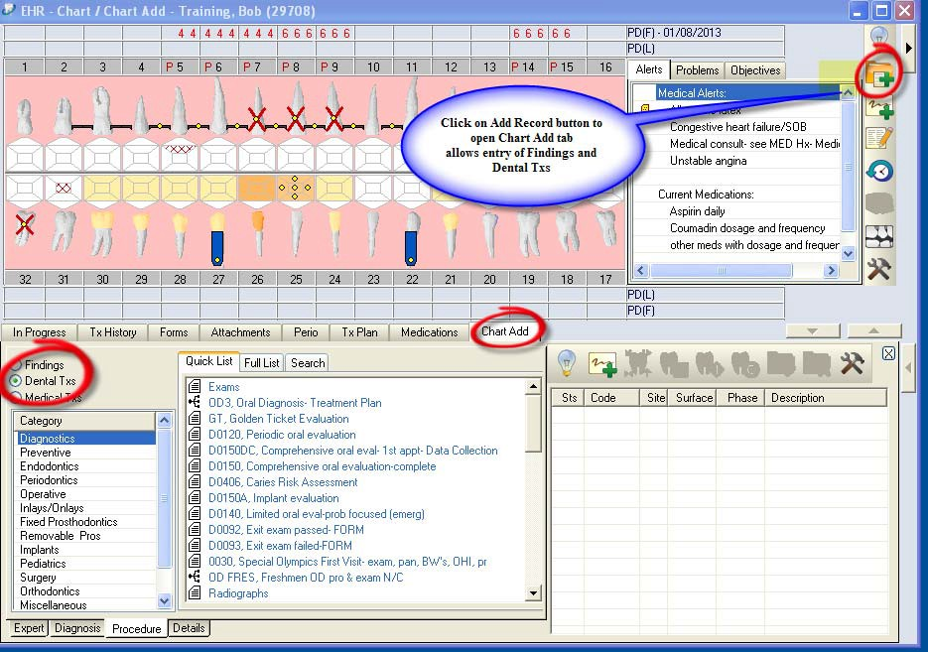
Chart Add tab appears-
Adding to the chart- Findings, Dental tx

Slide 46
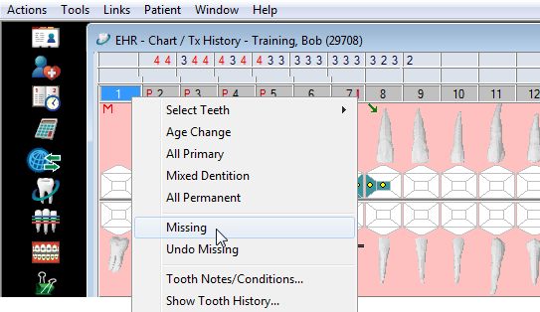
***1st step to charting: Select teeth and right click to indicate missing teeth

Slide 47
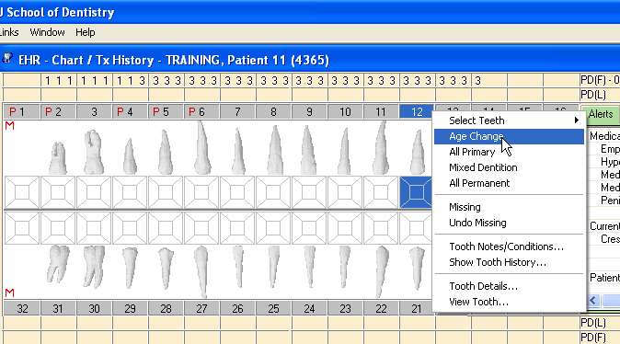
Select a tooth and right click to change to a primary tooth

Slide 48
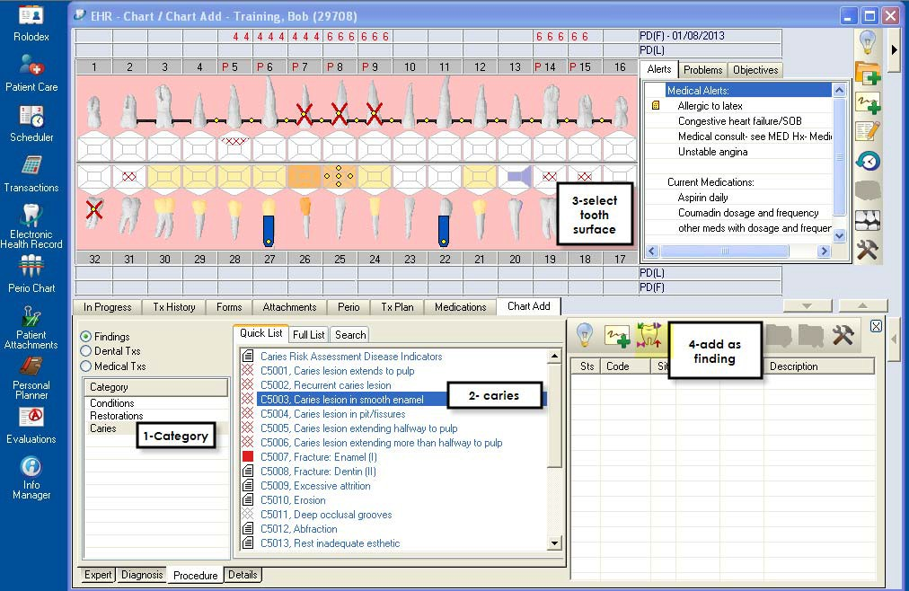
Findings button- chart existing restorations and new caries

Slide 49

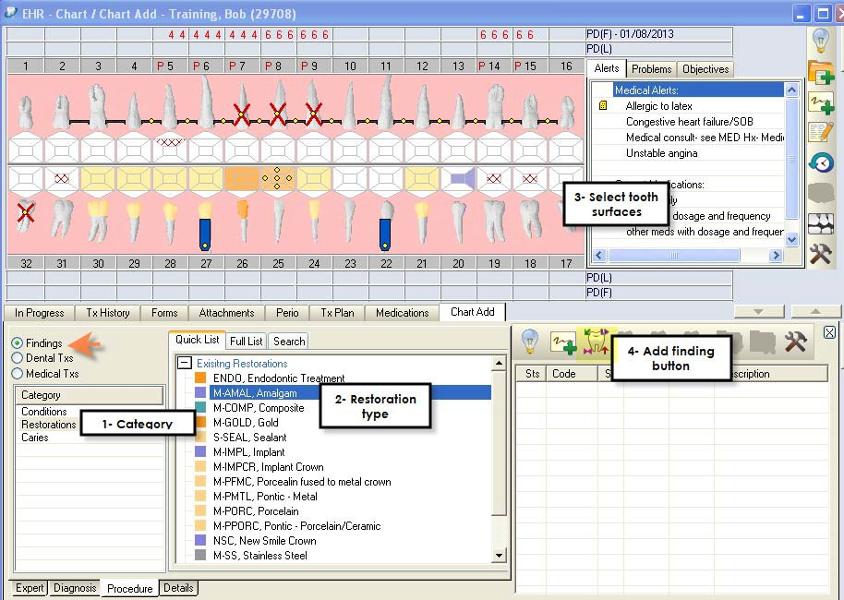
Chart existing restorations-
Add finding button

Slide 50
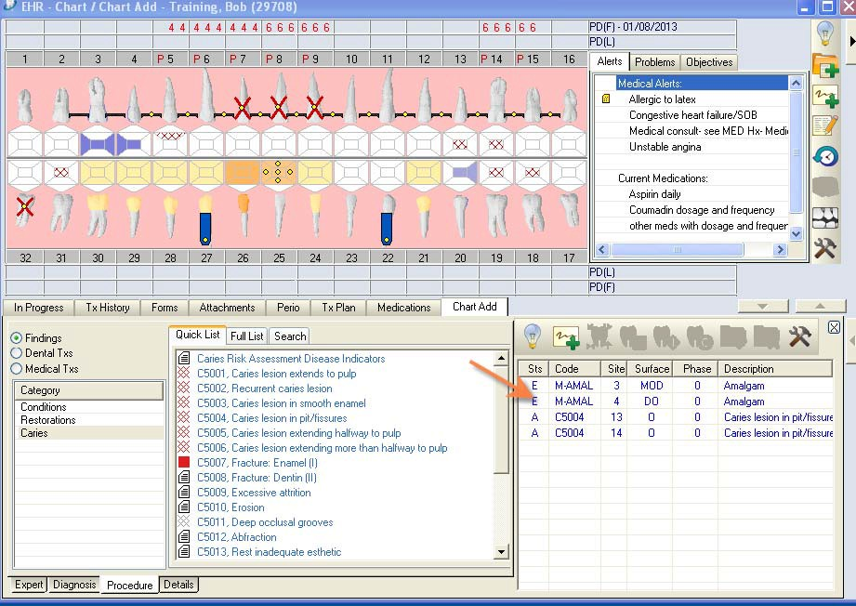
Findings -Existing restorations and caries added
Status A or E in Sts column

Slide 51
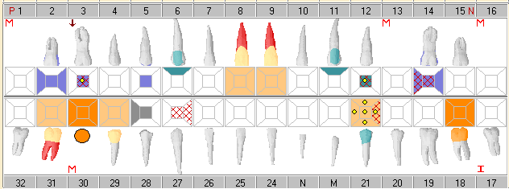
Odontogram
Displays Initial findings, planned and completed treatment

Slide 52

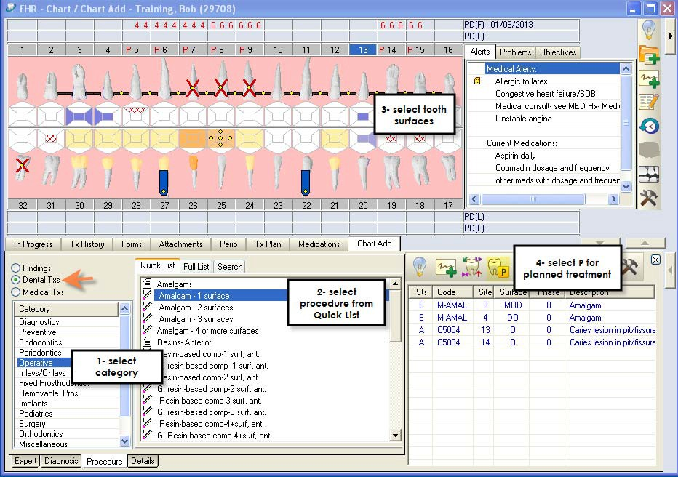
Chart planned treatment- Dental TXs button- use the plan treatment button

Slide 53
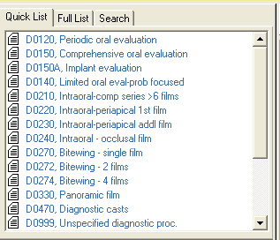
Choose treatment procedure from the Quick List

Slide 54

Choose a button
Add Note
Add
Add
Planned
Findings
Trmt
***Very Important:
Add Findings (existing restorations, caries, conditions) with Add Findings button only
Add Planned Dental Tx with Add Planned Treatment button only

Slide 55
Adding treatment
3 steps
Choose category
Choose procedure
Choose P for planned
Get faculty approval for planned treatment

Slide 56




Findings- restorations, caries, conditions Dental Txs- planned procedures

Slide 57

Adding Treatment Notes
Treatment notes must be added for every visit

Slide 58

Complete your note and hit Add New

Slide 59

Note appears in Tx History tab

Slide 60

Planned treatments- P in status column , red text
Yellow dots in odontogram indicate planned treatments

Slide 61

Alerts- click on red alert button - to view medical alerts for this patient

Slide 62

Click on red Alert button in status bar to see same medical alerts that appear in the EHR Alerts box next to odontogram

Slide 63


***Blue text means unapproved-
have faculty approve and grade at the end of each clinic session

Slide 64

Approved treatment turns text to black
and chart number button to grey

Slide 65



Tips:
Attrition- Select surface boxes in odontogram- should be occlusal surface only
Implant- tooth must be identified as missing first
ACC- all ceramic crown, porcelain
Collect signature window?- close the window for this exercise
Supernumerary tooth site = 50+ nearest tooth#
58 if it is nearest to tooth #8

Slide 66
Axium Help
Kathy Hansel Room 2305 504-941-8139
Jeff Schluter Room 3333 504-941-8183
E-mail
Internal message through axium

